Slide 1
LuNaVision AI:
An Intelligent Multi-Agent Pipeline for Automated Exoplanet Discovery from TESS Observations
PROJECT GUIDE
Mrs. M. Bhavadharini
Dr. S. Sasikala
TEAM MEMBERS
B R Prasanna
M Sandeep
S Gokul
PROJECT PHASE 1 / AI&DS

Slide 2
ABSTRACT
The discovery of exoplanets has become a rapidly growing field in modern astronomy, providing valuable insights into planetary systems beyond our solar system. Space missions such as NASA's Transiting Exoplanet Survey Satellite (TESS) generate vast amounts of stellar light curve data, making manual analysis increasingly difficult. To address this challenge, researchers have applied various Machine Learning (ML) and Deep Learning (DL) techniques, including Random Forest, Support Vector Machine (SVM), Convolutional Neural Networks (CNN), Long Short-Term Memory (LSTM), and Transformer-based models, to identify planetary transit signals and distinguish them from noise and false positives. While these approaches have achieved promising results, they are typically designed for individual stages of the detection process and often require manual intervention for preprocessing, validation, and interpretation. This project proposes LuNaVision AI: An Intelligent Multi-Agent Pipeline for Automated Exoplanet Discovery from TESS Observations, a collaborative AI framework that automates the complete exoplanet detection workflow. The proposed system employs specialized AI agents for astronomical data acquisition, light curve preprocessing, noise reduction, transit detection, exoplanet classification, orbital parameter estimation, explainable decision-making, and automated scientific report generation. By integrating Multi-Agent Systems, Large Language Models (LLMs), Explainable Artificial Intelligence (XAI), Machine Learning, Deep Learning, and time-series analysis, LuNaVision AI provides a scalable, interpretable, and intelligent solution for processing noisy astronomical datasets. The framework aims to improve detection accuracy, reduce false positives, minimize manual effort, and accelerate exoplanet discovery through an autonomous and efficient scientific analysis pipeline.
PROJECT PHASE 1 / AI&DS
02

Slide 3
OBJECTIVES
To develop an AI-based multi-agent framework for automated exoplanet discovery.
To automate TESS data acquisition and preprocessing.
To reduce noise in stellar light curves.
To detect potential planetary transit signals.
To classify exoplanet candidates and false positives.
To estimate orbital parameters.
To provide Explainable AI (XAI) for decisions.
To generate automated scientific reports.
To reduce manual effort and improve scalability.
PROJECT PHASE 1 / AI&DS
03

Slide 4
SCOPE OF THE PROJECT
Where it is used:
• Astronomical Research – Assist astronomers in analysing TESS observations.
• Exoplanet Discovery – Identify potential planets from stellar light curves.
• Space Missions – Support analysis of large-scale TESS datasets.
• Planetary System Studies – Assist in studying planets beyond our Solar System.
• Scientific Data Analysis – Automate processing of large and noisy astronomical datasets.
Benefits:
• Automates the exoplanet detection workflow.
• Reduces manual effort in data analysis.
• Reduces false positives during candidate identification.
• Handles large datasets efficiently.
• Improves interpretability using XAI.
• Generates automated scientific reports.
• Accelerates exoplanet discovery.
One-line Scope:
LuNaVision AI can be used as an intelligent assistance system for astronomers and space-research applications to automatically analyse TESS observations and identify potential exoplanet candidates.
PROJECT PHASE 1 / AI&DS
04

Slide 5
EXISTING SYSTEM
A CNN-Based Ensemble Model for Exoplanet Detection
Existing Approach:
Uses stellar flux (light intensity) for exoplanet detection.
• Applies multiple Machine Learning and Deep Learning models.
• Uses CNN-based ensemble learning for classification.
• Evaluates models using Accuracy, Precision, Sensitivity and Specificity.
• The proposed Ensemble-CNN achieved 99.62% accuracy in the study.
Existing System Workflow:
Stellar Light Intensity → Data Processing → ML/DL Models → Ensemble-CNN → Exoplanet Classification
Limitations :
• Mainly focuses on exoplanet classification.
• Does not provide a complete automated end-to-end discovery pipeline.
• Does not cover all stages such as data acquisition, orbital parameter estimation, XAI and automated scientific reporting.
Problem :
Need for an automated, scalable, and interpretable end-to-end exoplanet discovery pipeline.
PROJECT PHASE 1 / AI&DS
05

Slide 6
PROPOSED SYSTEM
LuNaVision AI
An intelligent multi-agent pipeline that automates the complete exoplanet discovery workflow.
Workflow :
TESS Data
↓
Preprocessing & Noise Reduction
↓
Transit Detection
↓
Exoplanet Classification
↓
Orbital Parameter Estimation
↓
XAI Interpretation
↓
Scientific Report
PROJECT PHASE 1 / AI&DS
06

Slide 7
PROPOSED SYSTEM
Key Technologies :
Multi-Agent Systems
ML & Deep Learning
LLMs
XAI
Time-Series Analysis
Advantages :
End-to-end automation
Reduced manual effort
Fewer false positives
Scalable & interpretable
PROJECT PHASE 1 / AI&DS
07

Slide 8
LITERATURE SURVEY
S.No | Title | Authors | Journal Name | Year | Methodology Used | Pros and Cons
1 | Exoplanet Imaging via Differentiable Rendering | Brandon Y. Feng, Rodrigo Ferrer-Chávez, Aviad Levis, William T. Freeman, Jason J. Wang | International Journal of Data Science and Analytics (Springer) | 2025 | Differentiable Rendering | Pros: Better contrast; improves faint-planet detection; uses wavefront data. Cons: High complexity; simulation-based; depends on wavefront data.
2 | Light intensity of stars for exoplanet detection | Jara-Maldonado, M. et al | IEEE Region 10 Symposium (TENSYMP) | 2022 | KNN + SMOTE | Pros: High accuracy; handles class imbalance; works with limited observations. Cons: Limited dataset; performance decreases with less data; mainly classification-focused.
3 | Feature extraction for exoplanet detection | Pimentel J, Amorim J, Rudzicz | International Journal of Data Science and Analytics (Springer) | 2024 | Feature Extraction | Pros: Uses multiple feature domains; strong classification performance; reduces dataset bias through cross-validation. Cons: Depends on preprocessing; requires feature engineering; feature importance needs further analysis.
4 | Scientific domain knowledge & deep learning | Ansdell, M. et al | The Astrophysical Journal Letters (IOP / AAS) | 2018 | Domain-Informed DL | Pros: Improves accuracy and recall; better detection of low-SNR transits; supports smaller models. Cons: Needs additional input data; requires centroid information; risk of overfitting.
PROJECT PHASE 1 / AI&DS
08

Slide 9
LITERATURE SURVEY
S.No | Title | Authors | Journal Name | Year | Methodology Used | Pros and Cons
5 | A CNN-based ensemble model for exoplanet detection. | Priyadarshini I, Puri V | Earth Science Informatics (Springer) | 2021 | Ensemble-CNN | Pros: High detection accuracy; improves model performance; combines multiple models. Cons: Higher complexity; increased computational cost; mainly classification-focused.
6 | Identifying Exoplanets with Deep Learning IV: Removing stellar activity signals from RV data using neural networks | de Beurs Z.L. et al | The Astronomical Journal (IOP / AAS) | 2022 | Neural Networks + Linear Regression | Pros: Removes stellar activity signals; improves RV quality; validated with real observations. Cons: Requires spectral information; generalization needs further testing; RV-focused.
7 | Discovering new worlds: signal processing methods for RV exoplanet detection. IEEE Signal Process | Khan, M.S., Jenkins, J., Yoma, N.B | IEEE Signal Processing Magazine (Vol. 34, pp.104–115) | 2017 | Signal Processing | Pros: Improves signal-to-noise ratio; provides statistical methods; useful for weak signals. Cons: Mainly RV-focused; relies on signal-processing techniques; not an automated AI pipeline.
8 | Exoplanet detection methods | Wright, J.T., Gaudi, B.S | Book chapter — Planets, Stars and Stellar Systems, Vol. 3 (Springer Netherlands); also on arXiv (2012) | 2012 | Detection Methods Review | Pros: Covers major detection methods; explains detection requirements; compares method sensitivity. Cons: Broad review; less focus on AI/ML; does not provide a new detection model.
PROJECT PHASE 1 / AI&DS
09

Slide 10
MODULES AND METHODOLOGIES
Modules :
Data Acquisition Agent
→ Collects TESS observations
Preprocessing Agent
→ Processes light curves
Noise Reduction Agent
→ Removes unwanted noise
Transit Detection Agent
→ Detects transit signals
Classification Agent
→ Identifies exoplanet candidates
Orbital Analysis Agent
→ Estimates orbital parameters
XAI Agent
→ Explains decisions
Report Generation Agent
→ Generates scientific reports
Methodology :
TESS → Preprocess → Denoise → Detect → Classify → Estimate → Explain → Report
PROJECT PHASE 1 / AI&DS
10

Slide 11
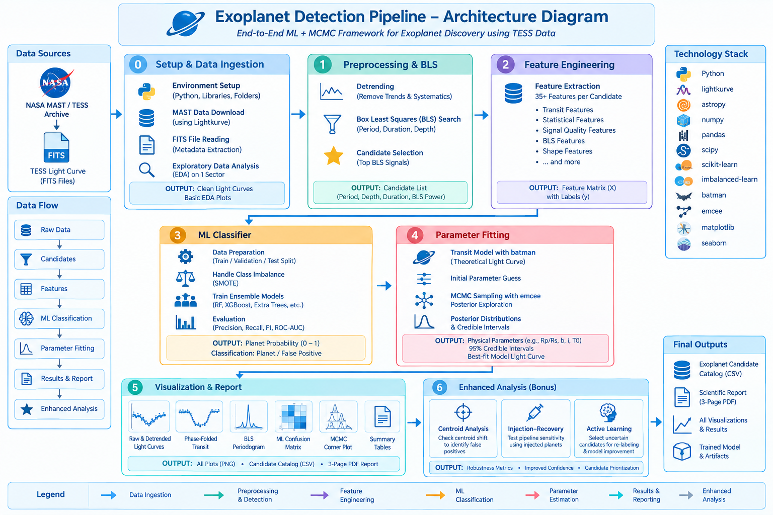
ARCHITECTURE DIAGRAM
PROJECT PHASE 1 / AI&DS
11

Slide 12
EXOPLANET DETECTION PIPELINE
Phase 0 — Setup & Data Ingestion
Objective: Collect and prepare TESS observation data for analysis.
Obtain TESS light-curve data from NASA MAST Archive.
Download and read FITS files containing stellar brightness observations.
Extract required target ID, time, flux and observation metadata.
Perform initial data quality checks and EDA.
Set up the Python environment and required astronomy/ML libraries.
Output:
TESS light curves
Metadata
Initial EDA results
PROJECT PHASE 1 / AI&DS
12

Slide 13
EXOPLANET DETECTION PIPELINE
Phase 1 — Preprocessing & BLS Detection
Objective: Clean the light curves and identify potential transit signals.
Remove long-term trends and instrumental variations through detrending.
Handle missing values, outliers and noisy observations.
Apply Box Least Squares (BLS) to search for periodic transit patterns.
Estimate candidate period, transit depth and duration.
Select the strongest BLS signals as potential exoplanet candidates.
Output:
Cleaned/detrended light curves
Potential exoplanet candidate list
BLS parameters
PROJECT PHASE 1 / AI&DS
13

Slide 14
EXOPLANET DETECTION PIPELINE
Phase 2 — Feature Engineering
Objective: Convert transit signals into meaningful numerical features for ML.
Extract 35+ features for each candidate.
Calculate transit characteristics such as depth, duration and period.
Generate statistical features such as mean, standard deviation, skewness and kurtosis.
Calculate signal-quality features such as SNR and noise level.
Include BLS-based and transit-shape features.
Output:
Feature Matrix X
Candidate labels y
ML-ready dataset
PROJECT PHASE 1 / AI&DS
14

Slide 15
EXOPLANET DETECTION PIPELINE
Phase 3 — ML Classifier
Objective: Automatically distinguish planetary candidates from false positives.
Prepare the feature dataset for training, validation and testing.
Handle class imbalance using SMOTE.
Train ensemble ML models such as:
  Random Forest
  XGBoost
  Extra Trees
Predict the probability of a candidate being planetary.
Evaluate using Precision, Recall, F1-score and ROC-AUC.
Target:
F1-score ≥ 90%
Output:
Trained ML ensemble
Planet probability
Planet / False Positive classification FESW
PROJECT PHASE 1 / AI&DS
15

Slide 16
EXOPLANET DETECTION PIPELINE
Phase 4 — Parameter Fitting
Objective: Estimate the physical and orbital parameters of high-confidence candidates.
Generate theoretical transit models using batman.
Use detected transit parameters as initial model estimates.
Apply MCMC sampling using emcee.
Estimate parameters such as:
  Planet-to-star radius ratio (Rp/Rs)
  Orbital period
  Impact parameter
  Inclination
  Transit midpoint
Calculate posterior distributions and credible intervals.
Output:
Best-fit transit model
Estimated planetary parameters
95% credible intervals
PROJECT PHASE 1 / AI&DS
16

Slide 17
EXOPLANET DETECTION PIPELINE
Phase 5 — Visualization & Report
Objective: Present the detection results in a clear scientific format.
Visualize raw and detrended light curves.
Generate phase-folded transit plots.
Plot the BLS periodogram.
Display the ML confusion matrix and performance metrics.
Generate MCMC corner plots for parameter uncertainty.
Create the final candidate catalog and scientific report.
Output:
PNG/PDF visualizations
Candidate catalog CSV
3-page scientific report
PROJECT PHASE 1 / AI&DS
17

Slide 18
EXOPLANET DETECTION PIPELINE
Phase 6 — Enhanced Analysis (Bonus)
Objective: Improve the reliability and robustness of the detection pipeline.
Centroid Analysis
Check whether the transit signal originates from the target star.
Detect possible background-source contamination.
Helps identify false positives.
Injection–Recovery
Inject artificial transit signals into real light curves.
Run the complete pipeline again.
Measure the pipeline's detection sensitivity.
Active Learning
Identify candidates where the ML model is uncertain.
Prioritize these candidates for additional review/labeling.
Use new labels to improve future model training.
Output:
Robustness metrics
Improved candidate confidence
Better candidate prioritization
PROJECT PHASE 1 / AI&DS
18

